Slide 1
The boy who cried wolf A story about telling lies
www.elsa-support.co.uk

Slide 2
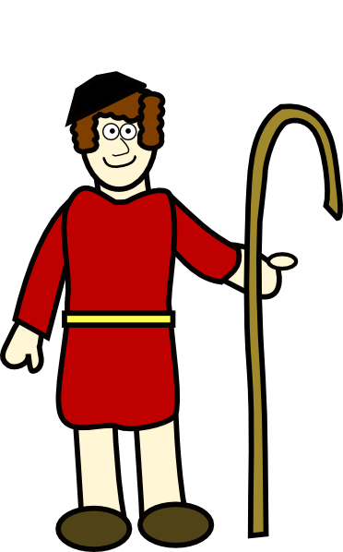
Once upon a time there was a shepherd boy who looked after a flock of sheep.

Slide 3
One day he was feeling a bit bored so thought he might have some fun. He decided to pretend that there was a wolf coming to eat the sheep. He ran down to the village shouting ‘Wolf, wolf there’s a wolf!’
Wolf, wolf there’s
a wolf!

Slide 4
The villagers came running to help and scare the wolf away.

Slide 5
The villagers were annoyed to find that there wasn’t a wolf at all. The villagers were angry!
%#$*?

Slide 6
The boy thought it was hilarious! He laughed and laughed and laughed.
HAHAHAHA!
Only joking!

Slide 7
The next day the shepherd boy decided to have some fun again and he ran down to the village again shouting ‘Wolf, wolf there really IS a wolf!’
Wolf, wolf there
really is a wolf!

Slide 8
The villagers came running AGAIN! But when they got there… yes you have guessed it. There was no sign of a wolf.

Slide 9
No wolf! The villagers were furious!
%#$*?

Slide 10
The shepherd boy thought it was so amusing! What great entertainment!
HAHAHAHA!
Only joking!

Slide 11
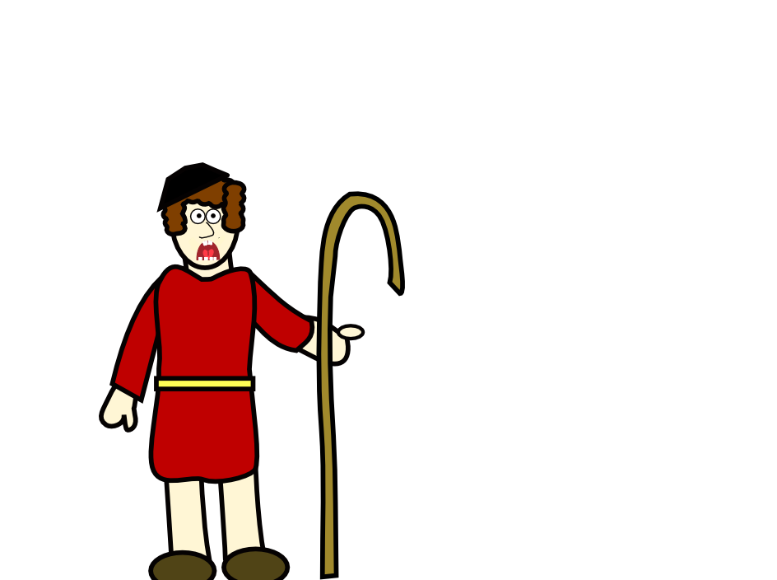
The next day the shepherd boy was tending his flock when all of a sudden…A WOLF appeared!
THERE’S A WOLF!

Slide 12
He ran as fast as his legs could carry him to the village. He said ‘There really IS a wolf this time!’ ‘I am not telling lies’. Do you think the villagers believed him?
Wolf, wolf there
really is a wolf!
I am NOT telling lies

Slide 13
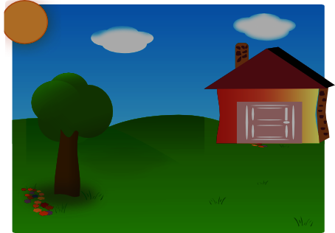
No they didn’t believe him. Why would they? He had told them twice already that there was a wolf and when they got there. No wolf!
There isn’t a wolf!
You are telling lies
again!

Slide 14
Of course the wolf killed and ate all the sheep!

Slide 15
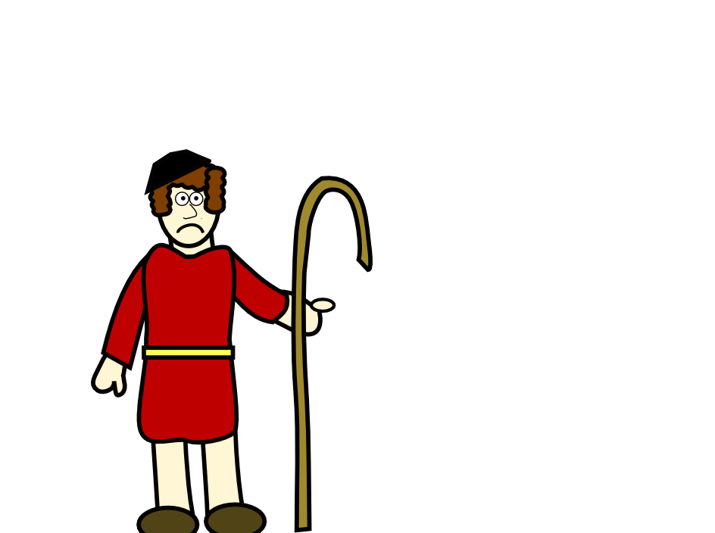
The shepherd boy was very sad. He said ‘I will never tell lies again!’
I will never tell
lies again!

