Slide 1
How can an ELSA help you?
Let’s find out!
www.elsa-support.co.uk

Slide 2
Here is a first aid kit and I am going to show you what is inside it…
First Aid Kit

Slide 3
Tissues
An ELSA can help to wipe away your tears when you feel sad or unhappy. ELSAs remind you that it is ok to let out your tears. A good cry can make you feel better. It is better to express your feelings rather than keep them bottled up inside you.

Slide 4
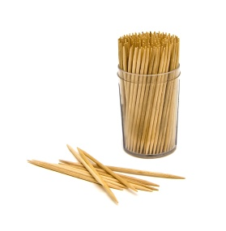
Toothpick
An ELSA will help you to unpick your problems and make sense of them. We all get problems from time to time and an ELSA will always listen to your problems and help you to find a solution.

Slide 5
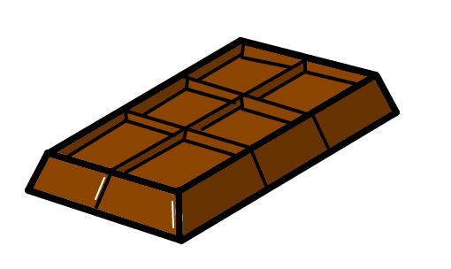
Chocolate bar
Seeing an ELSA is always a ‘treat’ – it never means that you are in trouble! Also, just like a treat, ELSAs can help you feel better when you are sad or upset. Your time with an ELSA will make you feel special and you will also have fun.

Slide 6
Star
Explorers from long ago used the “North Star” as a guide to help them stay on track and find their way when they were lost. Like the North Star, the ELSA can help you if you are feeling lost, confused, or unsure about how to solve a problem. They will support you in solving your problem.

Slide 7
Penny
Pennies have value and are often considered lucky – ‘Find a penny, pick it up…all day long you’ll have good luck!’ The penny reminds us that each and every one of us is valuable, special, and lucky to be who we are! The ELSA will remind you constantly about how special you are.

Slide 8
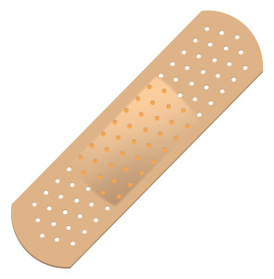
Plaster
ELSAs can help you to heal your wounds (the invisible ones that are deep inside of you). There are different ‘hurts’, ones that you can see such as a scraped knee, or a cut finger but somethings hurt us inside such as when our feelings are hurt or if your pet dies.

Slide 9
Swimming ring
ELSAs are there to talk to you and help ‘save’ you from scary, sad, or stressful situations. ELSAs will help you ‘stay afloat’ throughout the school year by giving you support, guidance, and kindness!

Slide 10
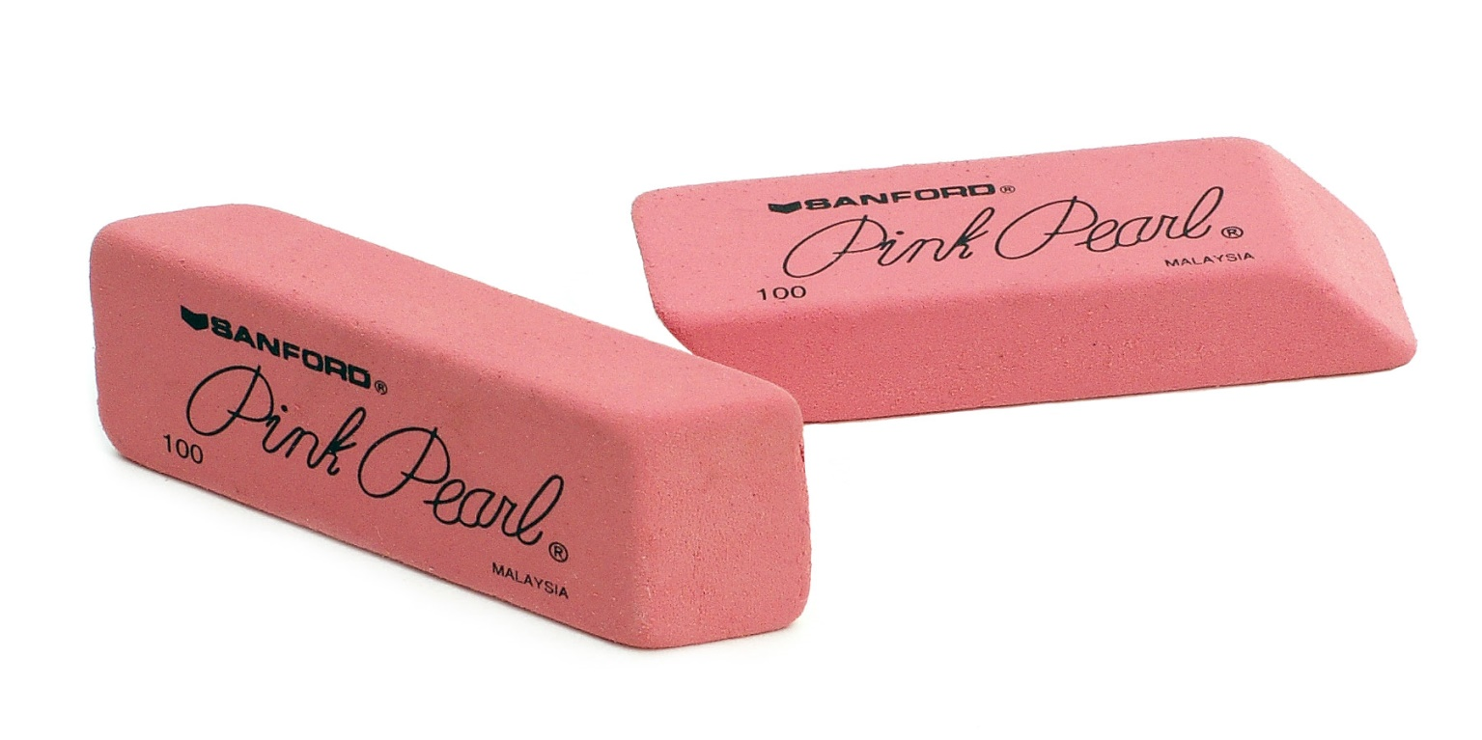
Eraser
Everyone makes mistakes and an ELSA can help you deal with your feelings when you make mistakes. She/He can also help you learn how to not make the same mistake again in the future! We can help you rub out the mistake and learn from it.

Slide 11
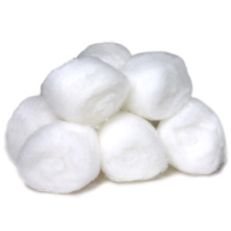
Cotton Wool Ball
Just like these cotton wool balls that feel soft and fuzzie, ELSAs are full of warm fuzzies and compliments. If you are feeling a bit down, sad or depressed then ask to see us or pop and see us at playtime/lunchtime and we can help to cheer you up!

Slide 12
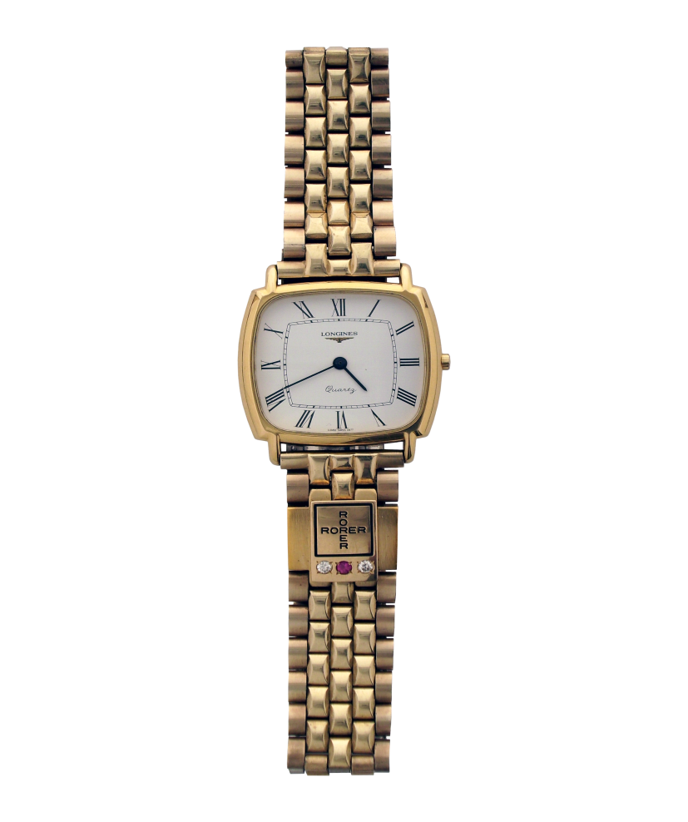
A watch
ELSAs will always find time to listen to you if you feel sad or have a problem.

Slide 13
Question Time
What do you think an ELSA does?
How can an ELSA help you?
What is an example of a time when you might need to see an ELSA?

