Slide 1
TERMS OF USE
This resource and its content is copyright of Elsa-Support Ltd.
©Elsa-Support 2021. All rights reserved.
All free products on this site are subject to a Creative Commons Copyright Licence. You are free to copy, distribute, display, and perform the work under the following conditions:
Attribution: You must give the original author credit - that is Elsa-Support, and our copyright labels must remain on the resource.
Non-Commercial: You may not use this work for commercial purposes. You cannot sell this work or use it for financial gain.
No Derivative Works: You may not alter, transform, or build upon this work. You must not change our work in anyway.
Thank you for abiding by copyright law.
www.elsa-support.co.uk

Slide 2
Other resources you will LOVE!
Please click the image to take you to this related and relevant resource:
www.elsa-support.co.uk

Slide 3
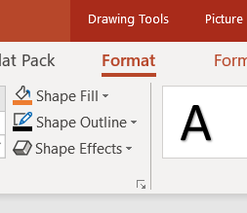
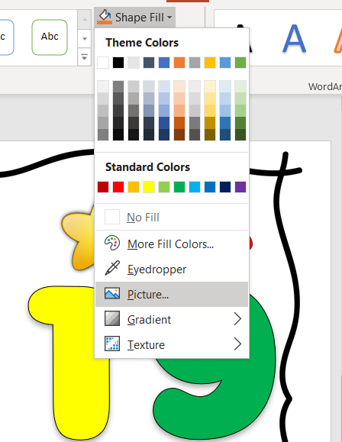
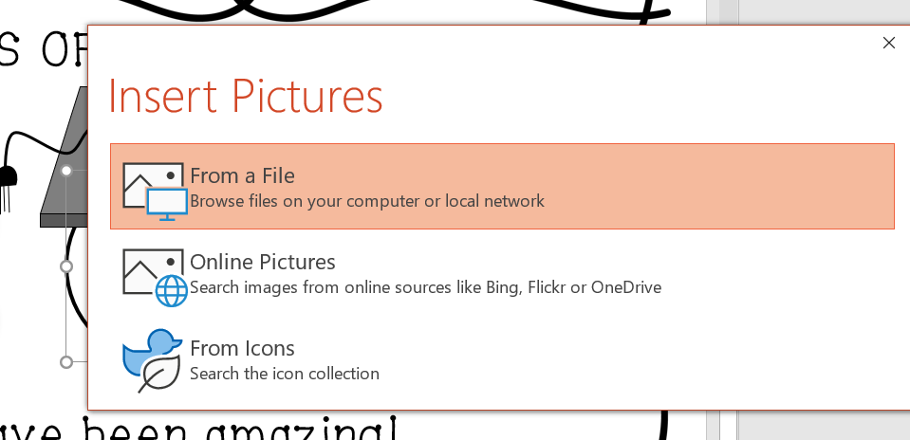
To change the image.
Click on the image
Click shape format
Click Shape fill
Choose Picture
Choose from a file and find the picture you want to insert. Click that and it will replace the emoji face.
To change the name, just click on it and type.

Slide 4
CLASS OF …
2
2
2
Samantha
You have been amazing!
Signed: Date:

